Slide 1
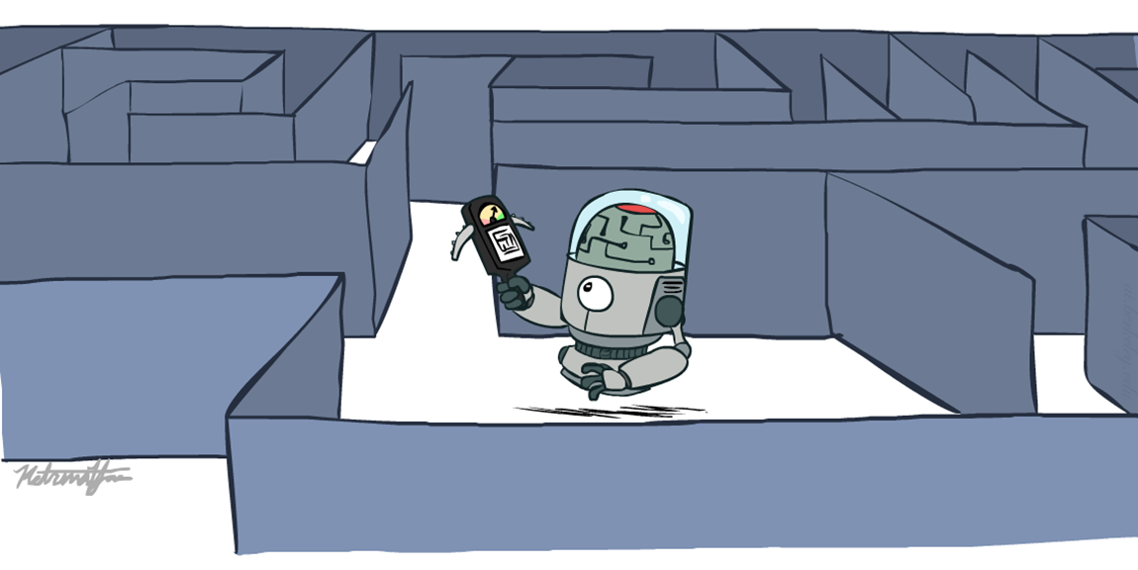
Informed Search
Heuristics Search

Slide 2
Uninformed Search Vs. Informed Search
Uninformed Search:
  “Which node should I explore next?” → no estimate of closeness to the goal
Informed Search:
  “Which node looks more promising?” → uses a heuristic to make that judgement

Slide 3
Informed Search
If you need to reach a destination, you could systematically explore roads, but information about estimated distance to the destination lets you prioritize roads that appear to take you toward it.
In informed search, the additional information used to guide the search is generally represented by a heuristic function. That's why informed search is also commonly called heuristic search.

Slide 4
Today
Informed Search
  Heuristics
  Greedy Search
  A* Search

Slide 5
Using problem specific knowledge to aid searching
With knowledge, one can search the state space as if he was given “hints” when exploring a maze.
  Heuristic information in search = Hints
  Imagine solving a maze.
  Uninformed search = randomly exploring paths.
  Informed search = someone telling you “the exit is somewhere on the right side”.
Leads to dramatic speed up in efficiency.
A
B
C
D
E
F
G
H
I
J
Search only in this sub-tree!!
K
L
M
N
O

Slide 6
What are Heuristics?
A heuristic is an estimate that helps the search algorithm determine how promising a state is with respect to reaching the goal.
Heuristics are obtained through a lot of experiences.
Heuristics often enable us to make decisions quickly without thinking deeply about the reasons.
The more experiences we have, the better the heuristics will be.
Example in real life:
  Doctors diagnosing disease based on symptoms
  Experienced chess players predicting good moves
Heuristics do not guarantee the best solution, but they guide the search effectively.

Slide 7
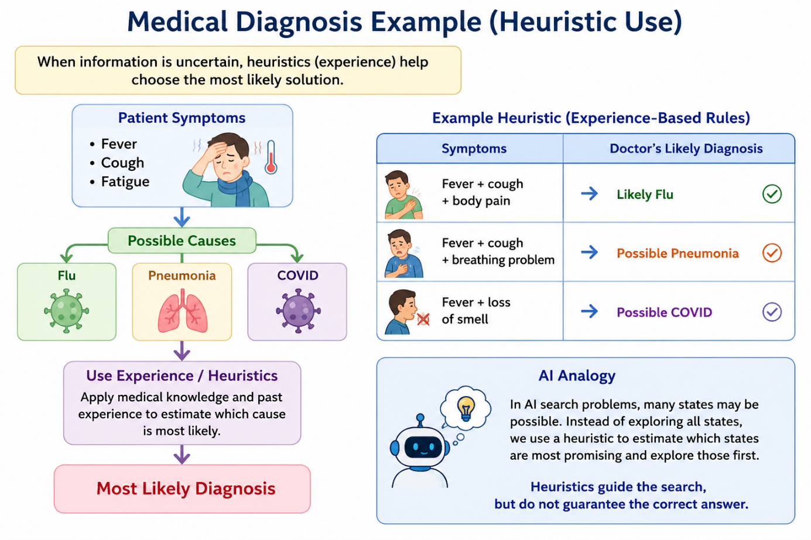
When Heuristics are used?
AI problem solvers employ heuristics in two basic situations:
When there is uncertainty – when the available information does not clearly identify the correct choice

Slide 8
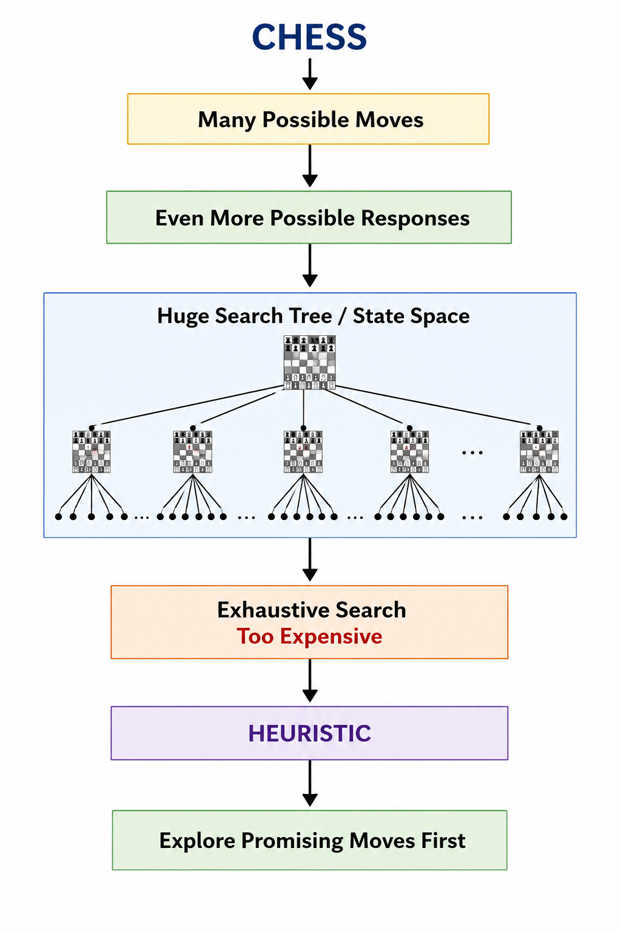
When Heuristics are used?
2. A problem may have an exact solution, but the computational cost of finding it may be prohibitive.
  The solution exists, but searching every possibility would take too much time or memory.
  Chess: state space growth is combinatorically explosive, with the number of possible states increasing with the depth of the search.
  Heuristics attack this complexity by guiding the search along the most “promising” path through the space.

Slide 9
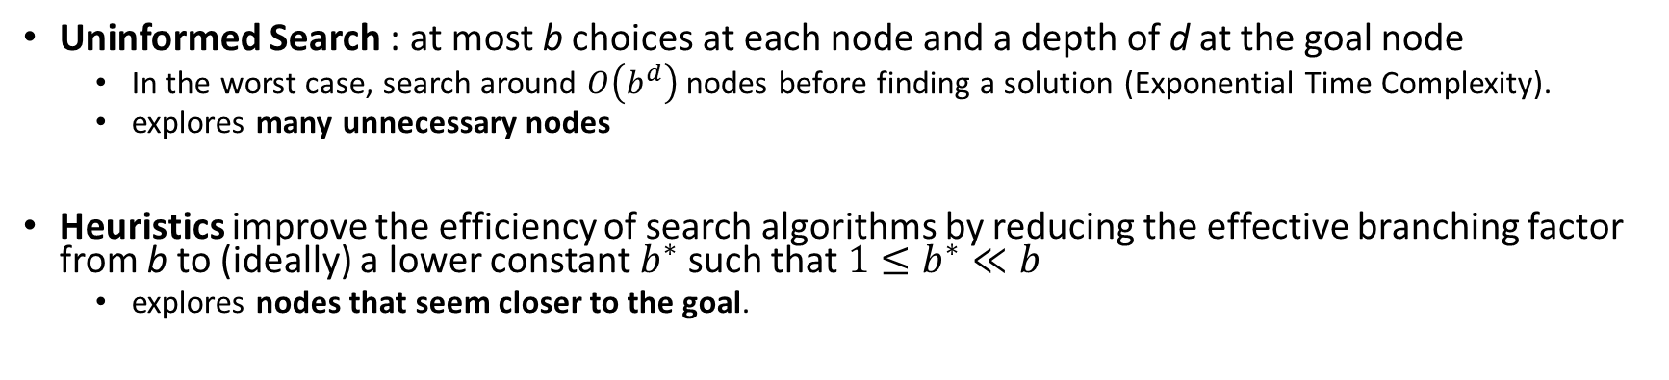
Why heuristic functions work?
Uninformed Search : at most b choices at each node and a depth of d at the goal node
  In the worst case, search around $O\left(b^{d}\right)$ nodes before finding a solution (Exponential Time Complexity).
  explores many unnecessary nodes
Heuristics improve the efficiency of search algorithms by reducing the effective branching factor from b to (ideally) a lower constant $b^{∗}$ such that$1≤b^{∗}≪b$
  explores nodes that seem closer to the goal.
Guide search towards the goal instead of all over the place
Start
Goal
Start
Goal
Informed
Uninformed

Slide 10
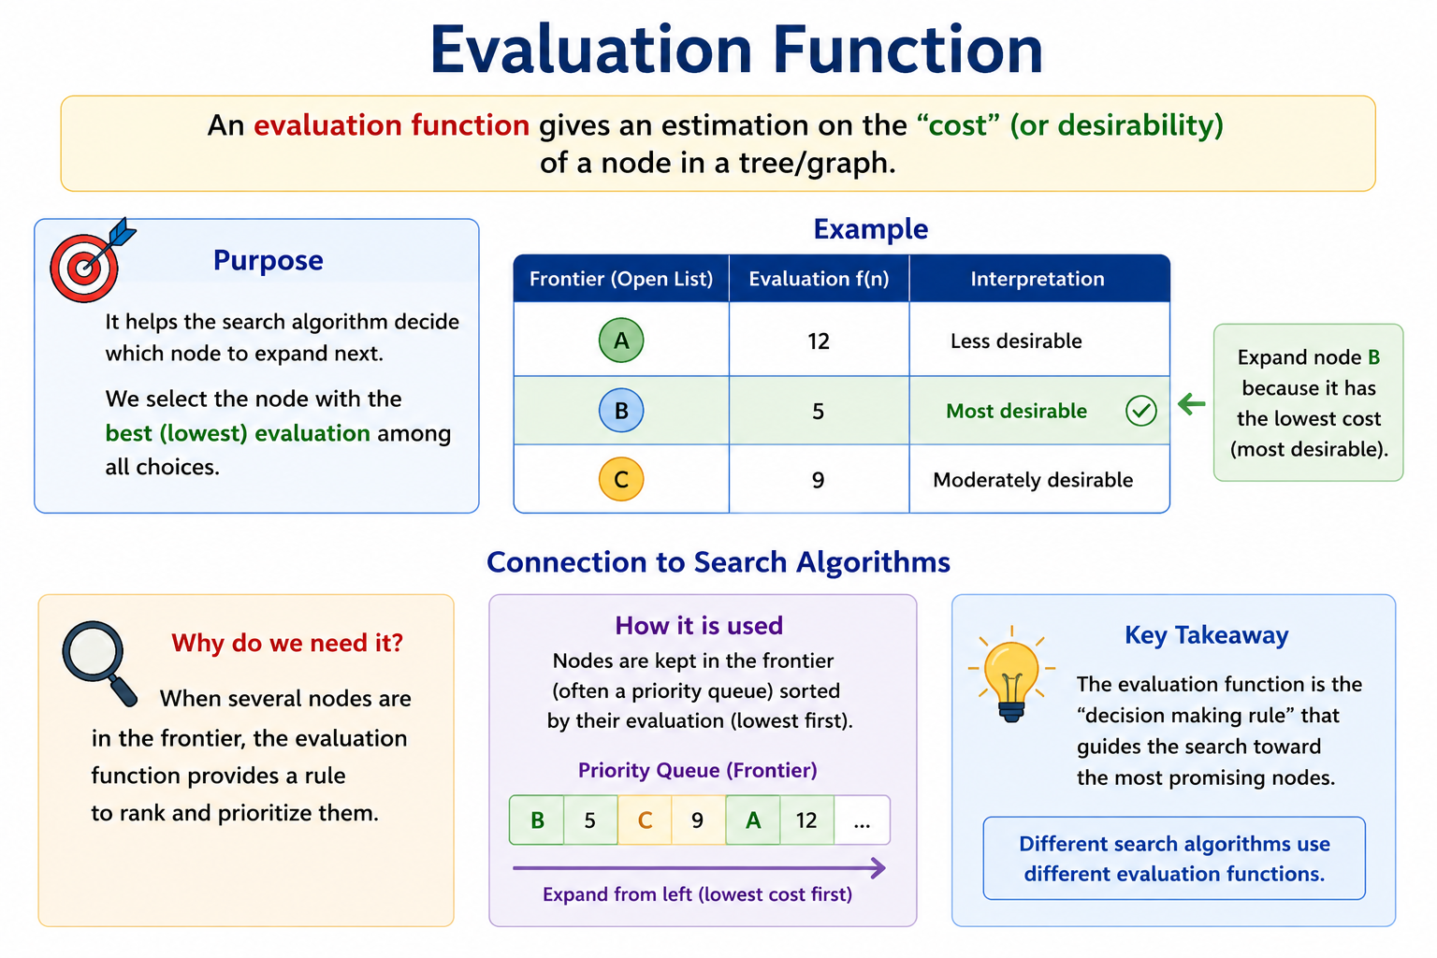

Slide 11
Evaluation / Heuristic Function
Suppose we are travelling from Lahore to Islamabad and we are currently at some intermediate city. There are two things we might want to know: how much distance have we already travelled, and approximately how much distance is still left?

Slide 12
Evaluation / Heuristic Function
Evaluation function f(n) = g(n) + h(n)
  g(n) = exact cost to reach n
  h(n) = estimated cost to goal from n
  f(n) = estimated total cost of cheapest path through n to goal

Slide 13
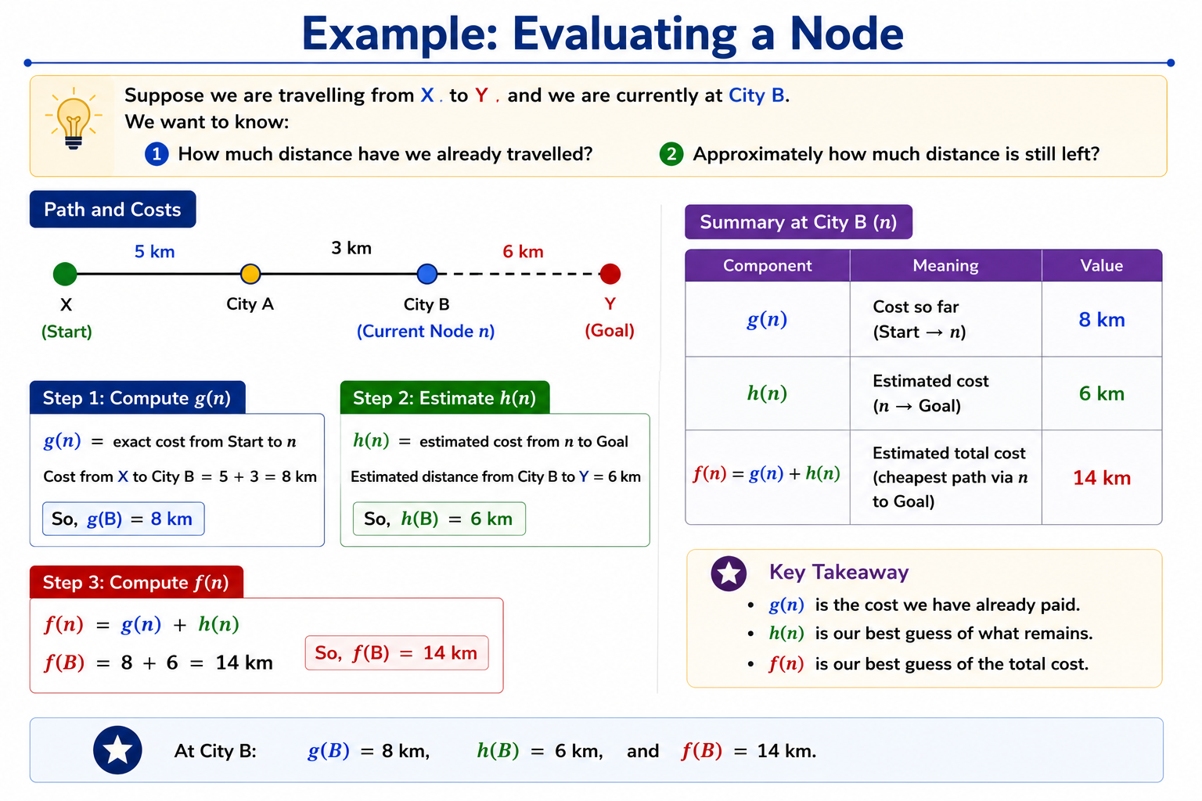

Slide 14
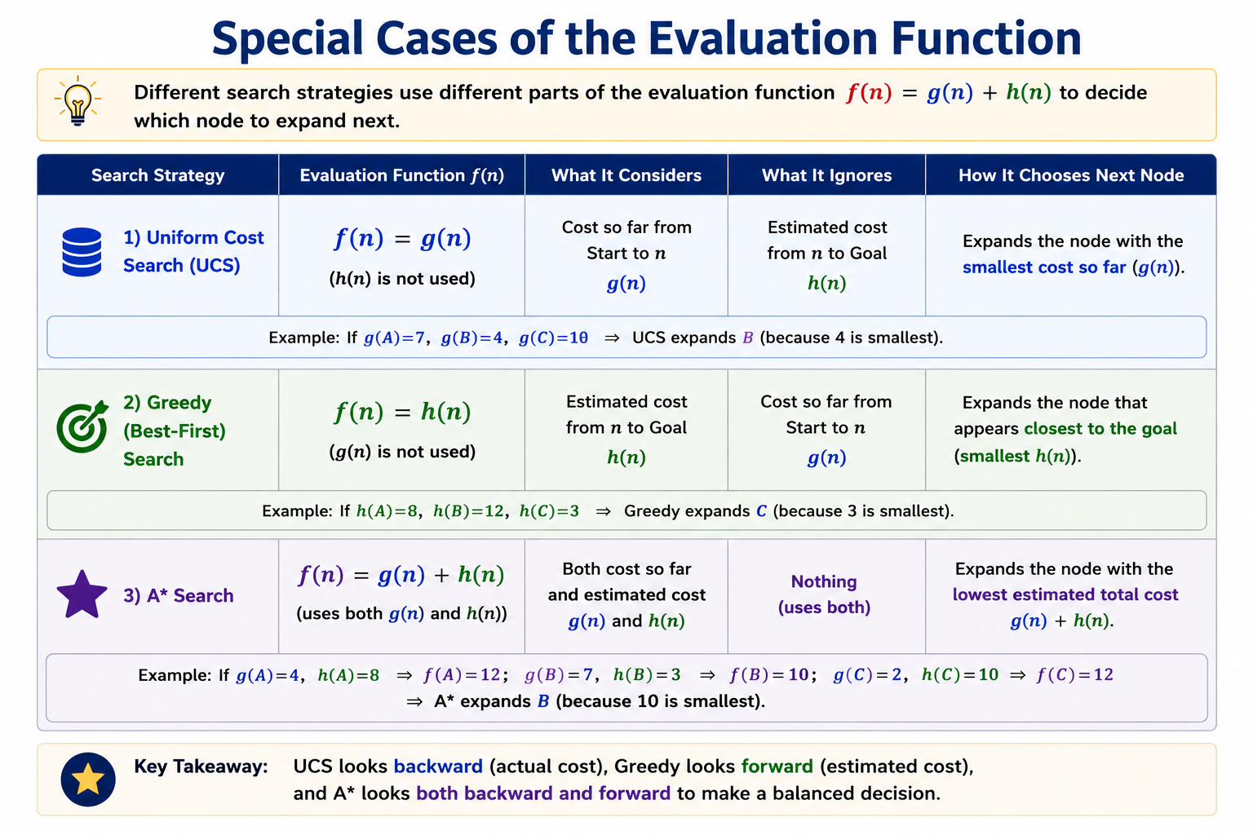

Slide 15
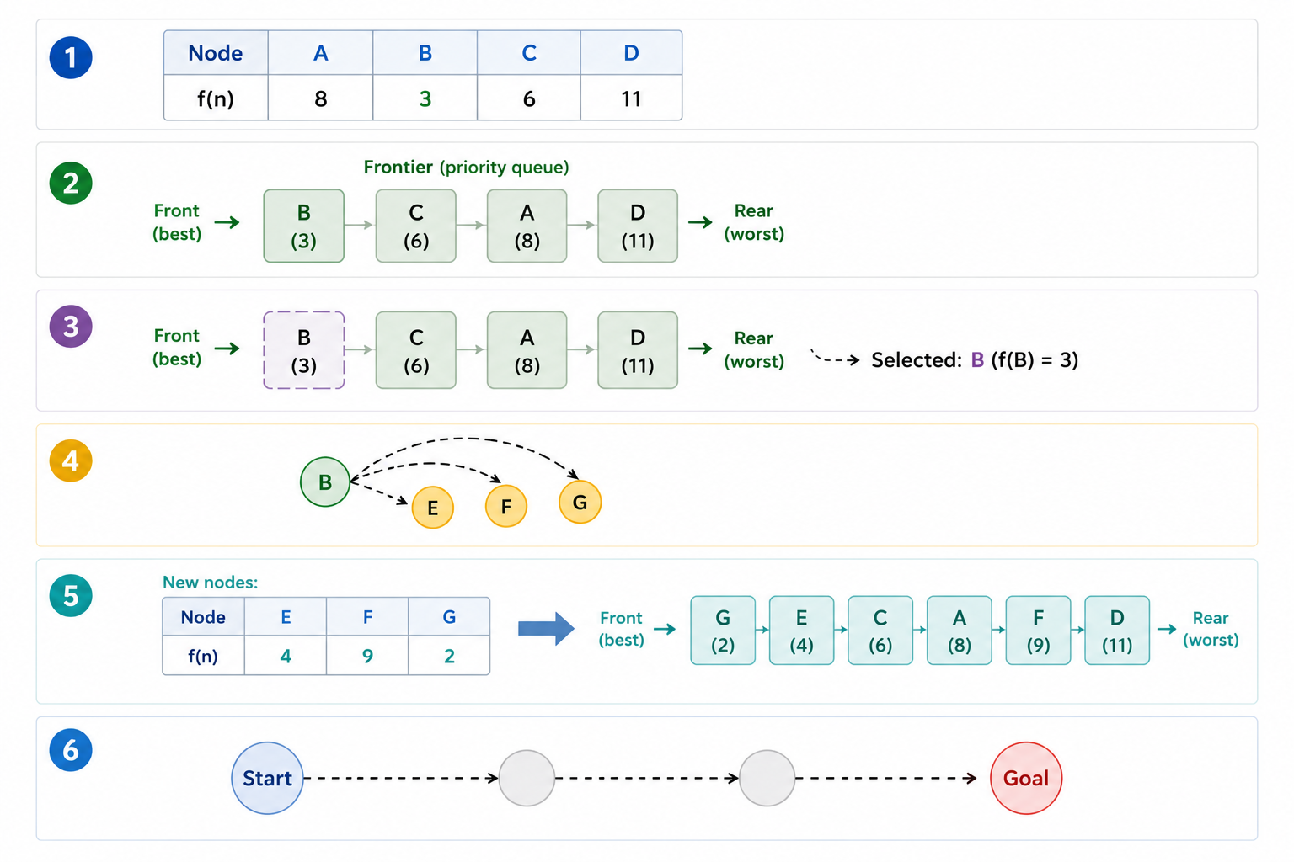
How it works?
Evaluate
Store in frontier
Select
Expand
Evaluate new nodes
Repeat step 3-5
The evaluation function determines what “most promising” means.

Slide 16
Heuristic Function
A heuristic function h(n) estimates the cost or distance from the current state n to the goal.
It is an estimate, not the actual cost.
It is problem-specific.
A good heuristic helps search focus on promising states.
Examples: Manhattan Distance and Euclidean Distance

Slide 17
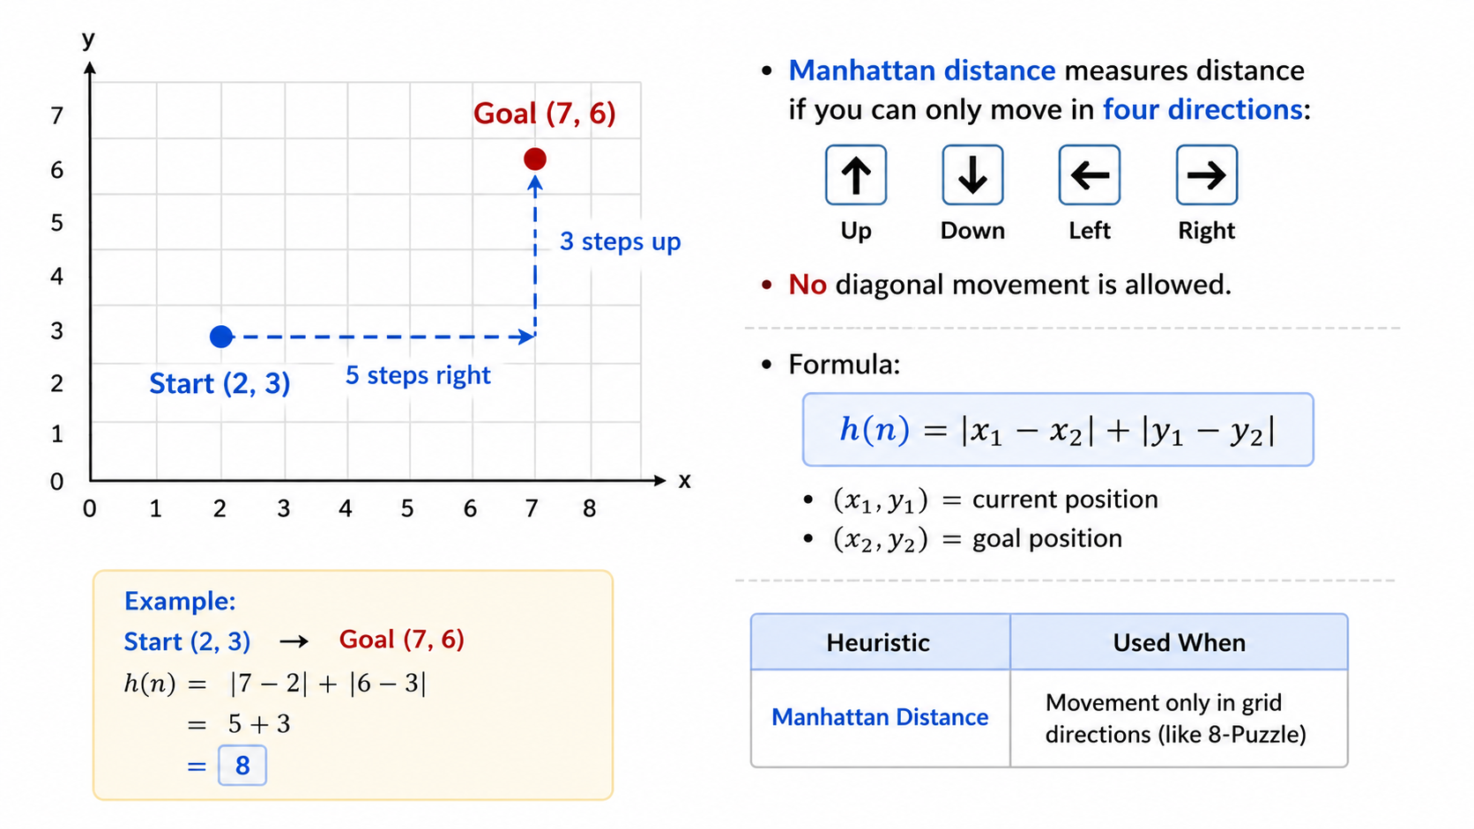
Manhattan Distance

Slide 18
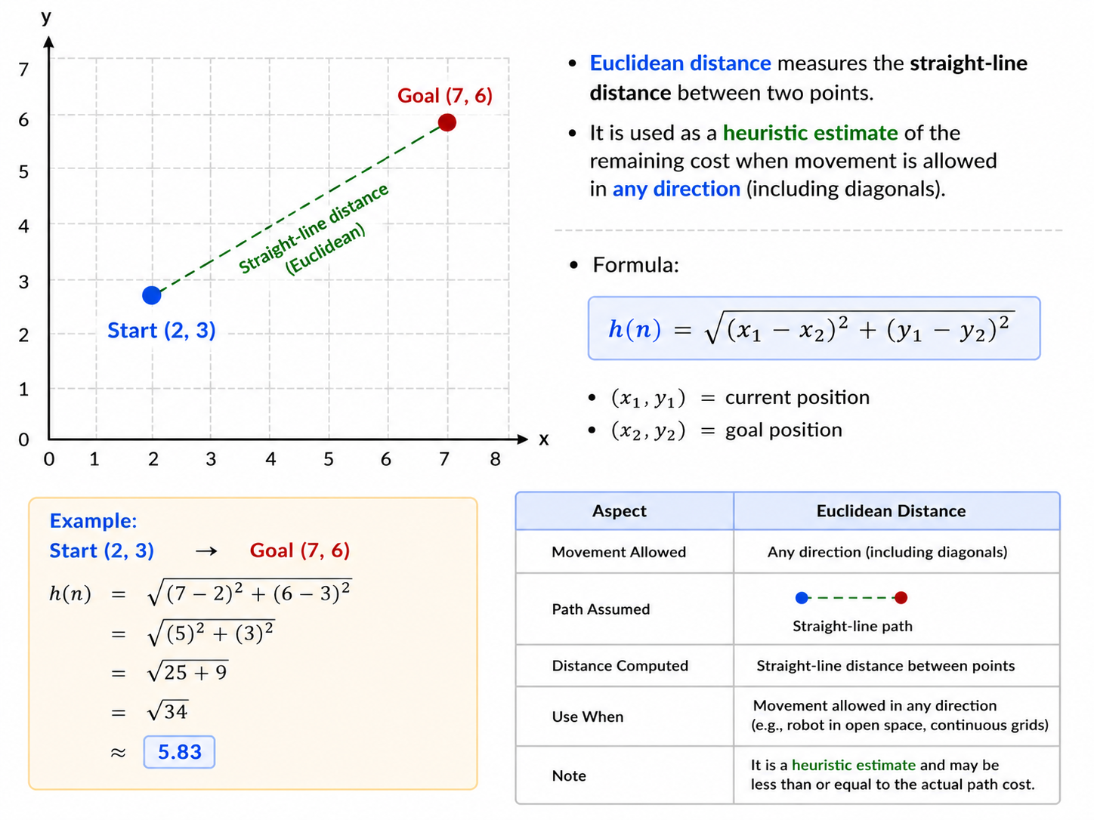
Euclidean Distance

Slide 19
Example: Heuristic Function
Our goal is Bucharest. For every city x, we have a heuristic value h(x), which estimates how far that city is from Bucharest.
The red table shows the heuristic function values.
These are straight-line distances from each city to Bucharest.
h(x)
h(x) = estimated distance from city x to the goal (Bucharest)
h(Arad) = 366 → straight line distance from Arad to Bucharest is 366

Slide 20
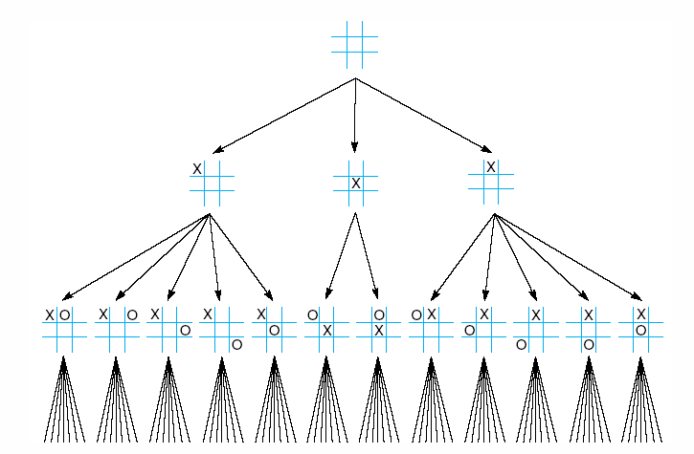
First three levels of the tic-tac-toe state space reduced by symmetry
A heuristic does not always have to be a physical distance.
Rotating the board produces the same state, so we ignore duplicates.

Slide 21
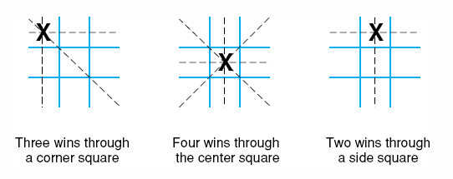
The “most wins” heuristic applied to the first children in tic-tac-toe.
Most Wins Heuristic: Choose moves that lead to maximum winning possibilities.

Slide 22
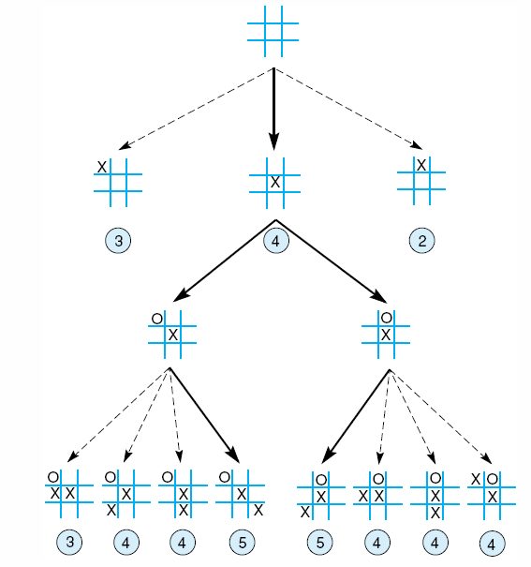
Heuristically reduced state space for tic-tac-toe
The Top Node (Initial State)
At the top, we see an empty board.
  From this state, player X can place a mark in any of the 9 squares.
  But many moves are symmetrical (they lead to equivalent boards).
  So instead of exploring all 9 possibilities, we consider only 3 representative moves:
    Corner
    Center
    Edge
This already reduces the search space.

Slide 23
Heuristically reduced state space for tic-tac-toe.
First Level of the Tree
The diagram shows three possible first moves for X.
Under each board you see a number (2, 3, 4, etc.).
These numbers represent the heuristic value.
  Meaning: How promising this board state is for player X.
Value | Meaning
Higher number | Better position for X
Lower number | Worse position

Slide 24
Heuristically reduced state space for tic-tac-toe.
Choosing the Best Move
Suppose the heuristic values are:
The algorithm chooses:
Middle board (value = 4)
Because the heuristic says this move gives better chances to win.
This means the algorithm does not explore all branches equally.

Slide 25
Heuristically reduced state space for tic-tac-toe.
Second Level of the Tree
Now player O makes a move.
From the chosen board, multiple states appear again.
Each resulting board again receives a heuristic evaluation.
Examples in the diagram:
  3
  4
  5
The algorithm again prefers the highest heuristic value.
Instead of checking every possible Tic-Tac-Toe board, the AI evaluates each board using a heuristic score and only explores the most promising moves.

Slide 26
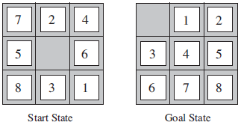
8–Puzzle: Heuristics?
One problem can have multiple possible heuristic functions.
h1: The number of misplaced tiles (squares with number).
h2: The sum of the distances of the tiles from their goal positions.

Slide 27
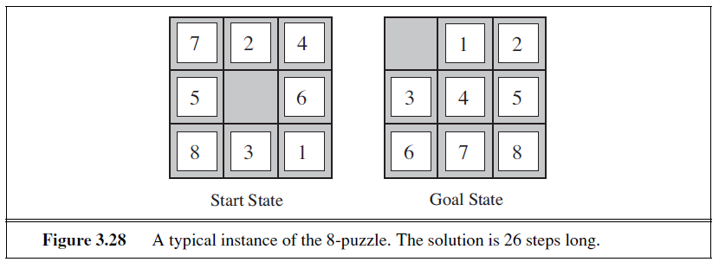
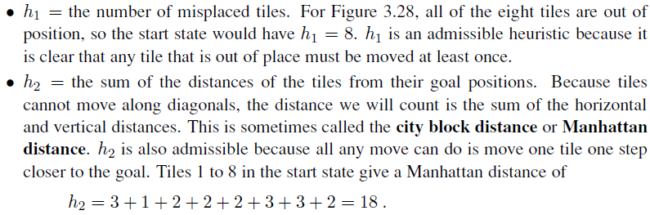

Slide 28
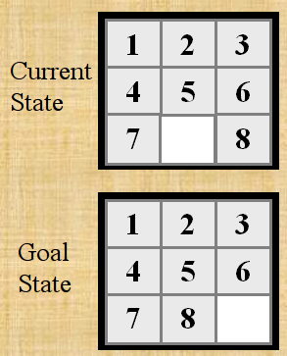

Slide 29
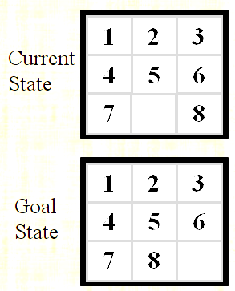
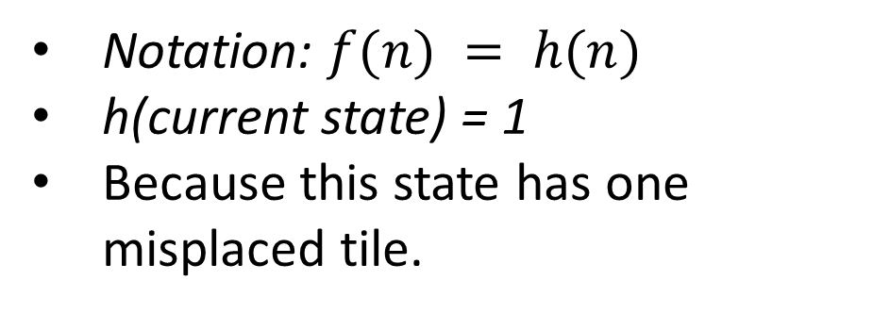
h1: The number of misplaced tiles (not including the blank)
Notation: $f(n) = h(n)$
h(current state) = 1
Because this state has one misplaced tile.
Only “8” is misplaced
So the heuristic function evaluates to 1.
The heuristic is telling us, that it thinks a solution might be available in just 1 more move.

Slide 30
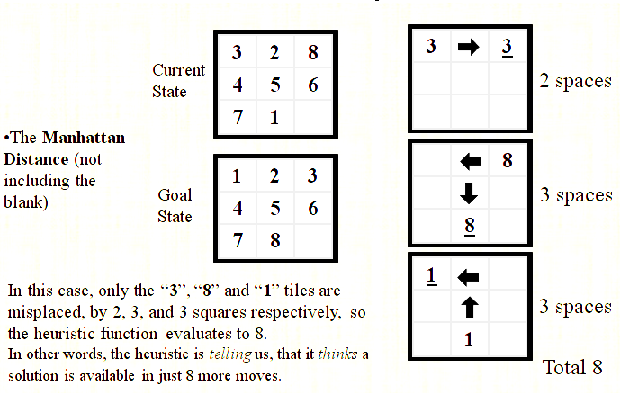
h2: The sum of the distances of tiles from goal positions
Notation: $f(n) = h(n)$, h(current state) = 8

Slide 31
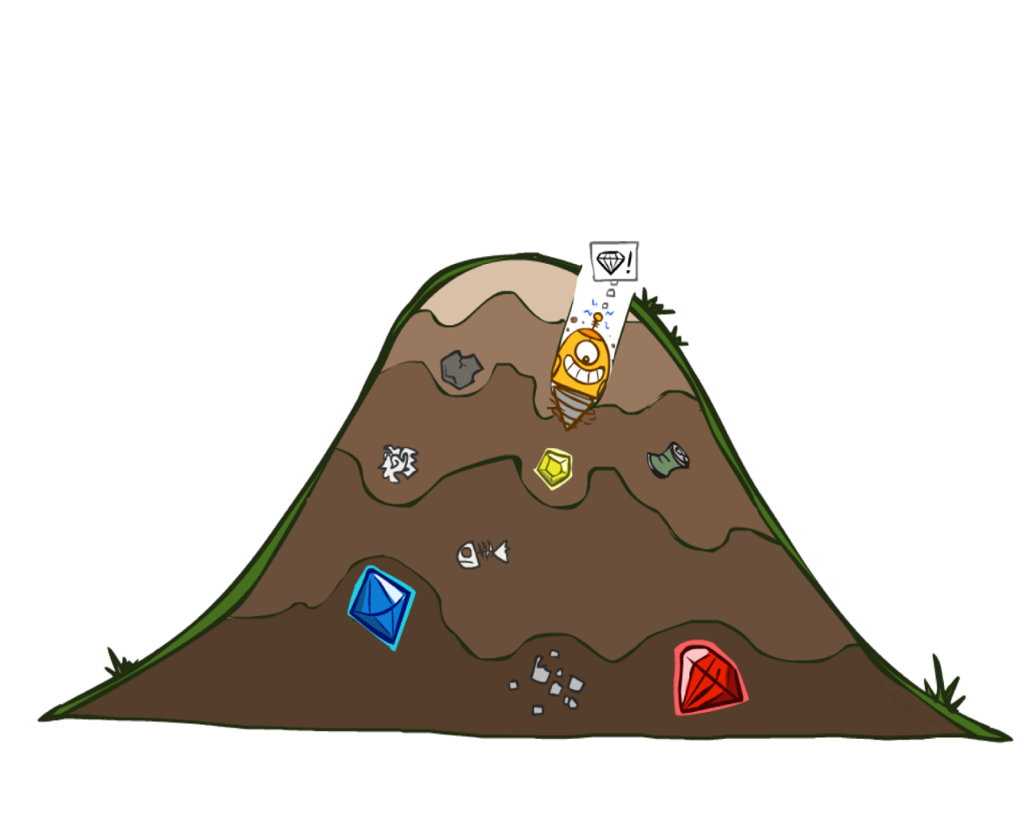
Greedy Best First Search
eval-fn: $f(n) = h(n)$

Slide 32
Greedy (Best-First) Search
Greedy Best-First Search expands the node that appears closest to the goal.
Use heuristic function f(n) = h(n)
Best-first search tries to expand the node that is closest to the goal, on the grounds that this is likely to lead to a solution quickly.
Choose path with low heuristic value

Slide 33
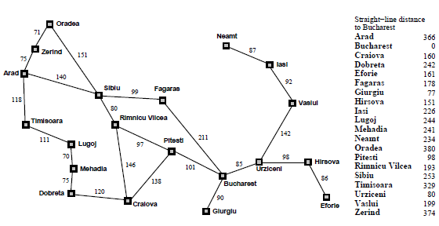

Slide 34

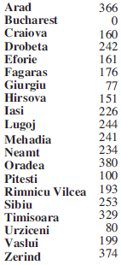
Greedy Search
Expand the node that seems closest…
What can go wrong?

Slide 35
Greedy Search
Expand the node that seems closest…(order frontier by h)
What can possibly go wrong?
Sibiu-Fagaras-Bucharest =
99+211 = 310
Sibiu-Rimnicu Vilcea-Pitesti-Bucharest =
80+97+101 = 278
h= 253
h=176
h=193
1000000
h=100
h=0

Slide 36
Greedy Search
b
…
Strategy: expand a node that you think is closest to a goal state
  Heuristic: estimate of distance to nearest goal for each state
A common case:
  Best-first takes you straight to the (wrong) goal
Worst-case: like a badly-guided DFS
b
…
Notes:
For any search problem, you know the goal. Now, you have an idea of how far away you are from the goal.

Slide 37
Best First Search (Greedy Search)
Algorithm
Let open be a priority queue containing initial state and closed be a queue containing visited states
  Loop
  If open is empty, return failure
  else
    Node← Remove-First (open) //remove element with highest priority from open and place it in closed
      If Node is goal then return path from initial to goal
    else
      Generate all successors of Node and place the successors into Open according to their heuristic values
  End loop

Slide 38
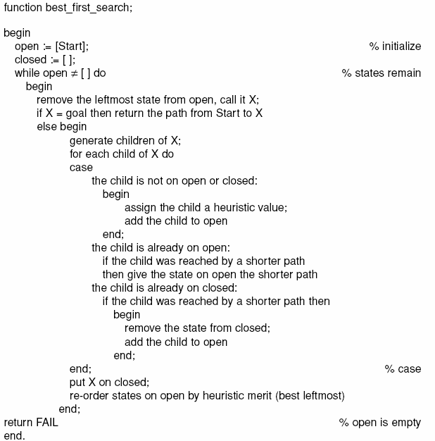

Slide 39
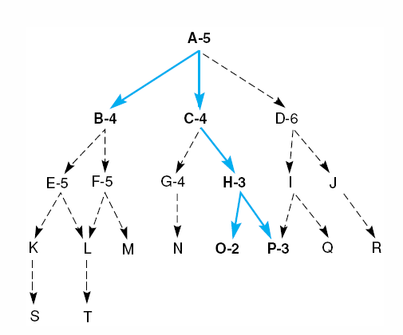
Best First Search
Task: Reach the goal state P
Open = [A5]; closed = [ ]
Evaluate A5; open = [B4, C4, D6]; closed = [A5]
Evaluate B4; open = [C4, E5, F5, D6]; closed = [B4, A5]
Evaluate C4; open = [H3, G4, E5, F5, D6]; closed [C4, B4, A5]
Evaluate H3; open = [O2, P3, G4, E5, F5, D6]; closed [H3, C4, B4, A5]
Evaluate O2; open = [P3, G4, E5, F5, D6]; closed [O2, H3, C4, B4, A5]
Evaluate P3; the solution is found

Slide 40
Greedy Search
State | Heuristic: h(n)
A | 366
B | 374
C | 329
D | 244
E | 253
F | 178
G | 193
H | 98
I | 0
Start
A
75
118
140
B
C
111
E
D
80
99
G
F
97
H
211
101
I
Goal
f(n) = h (n) = straight-line distance heuristic

Slide 41
Greedy Search: Tree Search
Start
A

Slide 42
Greedy Search: Tree Search
Start
A
75
118
[329]
140
[374]
B
C
[253]
E

Slide 43
Greedy Search: Tree Search
Start
A
75
118
[329]
140
[374]
B
C
[253]
E
80
99
[193]
[178]
G
F
[366]
A

Slide 44
Greedy Search: Tree Search
Start
A
75
118
[329]
140
[374]
B
C
[253]
E
80
99
[193]
[178]
G
F
[366]
A
211
[253]
I
[0]
E
Goal

Slide 45
Greedy Search: Tree Search
Start
A
75
118
[329]
140
[374]
B
C
[253]
E
80
99
[193]
[178]
G
F
[366]
A
211
[253]
I
[0]
E
Path cost(A-E-F-I) = 253 + 178 + 0 = 431
dist(A-E-F-I) = 140 + 99 + 211 = 450
Goal

Slide 46
Greedy Search: Optimal?
State | Heuristic: h(n)
A | 366
B | 374
C | 329
D | 244
E | 253
F | 178
G | 193
H | 98
I | 0
Start
A
75
118
140
B
C
111
E
D
80
99
G
F
97
H
211
101
I
Goal
f(n) = h (n) = straight-line distance heuristic
dist(A-E-G-H-I) =140+80+97+101=418
Not optimal!

Slide 47
Greedy Search: Complete ?
State | Heuristic: h(n)
A | 366
B | 374
** C | 250
D | 244
E | 253
F | 178
G | 193
H | 98
I | 0
Start
A
75
118
140
B
C
111
E
D
80
99
G
F
97
H
211
101
I
Goal
f(n) = h (n) = straight-line distance heuristic

Slide 48
Greedy Search: Tree Search
Start
A

Slide 49
Greedy Search: Tree Search
Start
A
75
118
[250]
140
[374]
B
C
[253]
E

Slide 50
Greedy Search: Tree Search
Start
A
75
118
[250]
140
[374]
B
C
[253]
E
111
[244]
D

Slide 51
Greedy Search: Tree Search
Start
A
75
118
[250]
140
[374]
B
C
[253]
E
111
[244]
D
Infinite Branch !
[250]
C

Slide 52
Greedy Search: Tree Search
Start
A
75
118
[250]
140
[374]
B
C
[253]
E
111
[244]
D
Infinite Branch !
[250]
C
[244]
D

Slide 53
Greedy Search: Tree Search
Start
A
75
118
[250]
140
[374]
B
C
[253]
E
Even Incomplete in finite state space much like depth first search
(Complete in finite space with repeated-state checking)
111
[244]
D
Infinite Branch !
[250]
C
Greedy search can fail because:
It may follow a path that always looks promising
That path may lead to an infinite branch or loop
[244]
D

Slide 54
Greedy Search: Time and Space Complexity ?
Start
Greedy search is not optimal.
Greedy search is not complete
In the worst case, the Time and Space Complexity of Greedy Search are both O(b^{m})
Where b is the branching factor and m the maximum path length
A
75
118
140
B
C
111
E
D
80
99
G
F
97
H
211
101
I
Goal

Slide 55
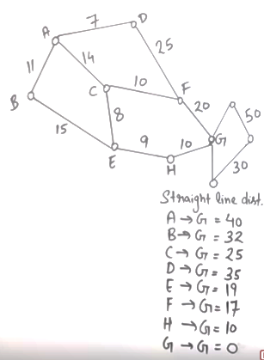
 | Frontier (Greedy) | Expand | Explored
1 | (A,40) |  | Empty

Slide 56
 | Frontier (Greedy) | Expand | Explored
1 | (A,40) | A | Empty

Slide 57
 | Frontier (Greedy) | Expand | Explored
1 | (A,40) | A | Empty
2 | (A-B,32)(A-C,25)(A-D,35) |  | A

Slide 58
 | Frontier (Greedy) | Expand | Explored
1 | (A,40) | A | Empty
2 | (A-B,32)(A-C,25)(A-D,35) | C | A

Slide 59
 | Frontier (Greedy) | Expand | Explored
1 | (A,40) | A | Empty
2 | (A-B,32)(A-C,25)(A-D,35) | C | A
3 | (A-B,32)(A-D,35) (A-C-E,19)(A-C-F,17) |  | A,C

Slide 60
 | Frontier (Greedy) | Expand | Explored
1 | (A,40) | A | Empty
2 | (A-B,32)(A-C,25)(A-D,35) | C | A
3 | (A-B,32)(A-D,35) (A-C-E,19)(A-C-F,17) | F | A,C

Slide 61
 | Frontier (Greedy) | Expand | Explored
1 | (A,40) | A | Empty
2 | (A-B,32)(A-C,25)(A-D,35) | C | A
3 | (A-B,32)(A-D,35) (A-C-E,19)(A-C-F,17) | F | A,C
4 | (A-B,32)(A-D,35) (A-C-E,19)(A-C-F-G,0) |  | A,C,F

Slide 62
 | Frontier (Greedy) | Expand | Explored
1 | (A,40) | A | Empty
2 | (A-B,32)(A-C,25)(A-D,35) | C | A
3 | (A-B,32)(A-D,35) (A-C-E,19)(A-C-F,17) | F | A,C
4 | (A-B,32)(A-D,35) (A-C-E,19)(A-C-F-G,0) | G | A,C,F

Slide 63
 | Frontier (Greedy) | Expand | Explored
1 | (A,40) | A | Empty
2 | (A-B,32)(A-C,25)(A-D,35) | C | A
3 | (A-B,32)(A-D,35) (A-C-E,19)(A-C-F,17) | F | A,C
4 | (A-B,32)(A-D,35) (A-C-E,19)(A-C-F-G,0) | G | A,C,F
5 | (A-C-F-G,0) Goal Found

Slide 64
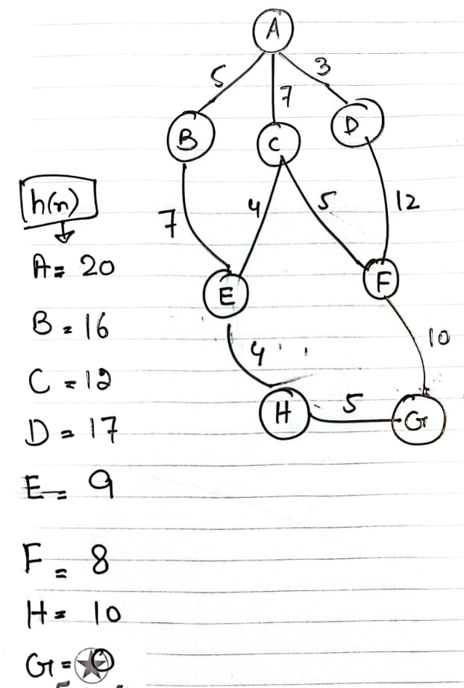

Slide 65
 | Frontier (Greedy) | Expand | Explored
1 | (A,40) | A | Empty
2 | (A-C,25) (A-B,32)(A-D,35) | C | A
3 | (A-B,32)(A-D,35)(A-C-F,17)(A-C-E,19) | F | A,C
4 | (A-B,32)(A-D,35)(A-C-F-G,0)(A-C-E,19) | G | A,C,F
5 | (A-C-F-G) Goal Found |  | A,C,F,G
 | Frontier (UCS) | Expand | Explored
1 | (A,0) | A
2 | (A-B,11)(A-C,14)(A-D,7) | D | A
3 | (A-B,11)(A-C,14)(A-D-F,32) | B | A,D
4 | (A-B-E,26)(A-C,14)(A-D-F,32) | C | A,D,B
5 | (A-B-E,26)(A-C-F,24)(A-C-E,22)(A-D-F,32) | E | A,D,B,C
6 | (A-B-E,26)(A-C-F,24)(A-C-E-H,31)(A-D-F,32) | F | A,D,B,C,E
7 | (A-B-E,26)(A-C-F-G,44)(A-C-E-H,31)(A-D-F,32) | E | A,D,B,C,E,F
8 | (A-B-E,26)(A-C-F-G,44)(A-C-E-H,31)(A-D-F,32) | F
9 | (A-B-E,26)(A-C-F-G,44)(A-C-E-H,31)(A-D-F,32) | H
10 | A-C-E-H-G,41 Goal Found

Slide 66
Heuristics
Problem:
  A heuristic is only an informed guess of the next step to be taken in solving a problem.
  It is often based on experience or intuition.
  Heuristics use limited information, such as knowledge of the present situation or descriptions of states currently on the open list.
  They are not always able to predict the exact behavior of the state space farther along in the search.
  A heuristic can lead a search algorithm to a suboptimal solution or fail to find any solution at all. This is an inherent limitation of heuristic search.

